Slide 1

Layering in Computer Networking Dr. Lixin Wang Professor TSYS School of Computer Science

Slide 2
What is the TCP/IP protocol model designed for?
Discussion Question

Slide 3

The TCP/IP protocol model was designed to ……
Host A
Host B
Notes:
to study the data communication (OR data exchange) between two applications running in two different hosts.
Example: data exchange between a web browser and a web server

Slide 4
We begin with an example - an airline system
How to describe a complicated airline system?
Can we find a structure to describe this complex system that has the following?
ticketing agents,
baggage checkers,
gate personnel,
pilots,
airplanes,
air traffic control, and
a worldwide system for routing airplanes

Slide 5
One way to describe an airline system is to describe the series of actions you take when you fly on an airline

Slide 6
Key functions of an airline system
a ticketing function at each end (departure and arrival)
a baggage function for already-ticketed passengers at each end
a gate function for already-ticketed and baggage-checked passengers at each end
These functions are symmetric at both ends, which motivate us to look at the airline system in a horizontal manner

Slide 7
Layered architecture of the airline system

Slide 8
Layered Architecture (2)
Note that each layer, combined with the layers below it, implements some functionality (service)
At the ticketing layer and below, airline-counter-to-airline-counter transfer of a person is accomplished
At the baggage layer and below, baggage-check-to-baggage-claim transfer of a person and bags is accomplished

Slide 9
Layered Architecture (3)
At the gate layer, departure-gate-to-arrival-gate transfer of a person and bags is accomplished.
At the takeoff/landing layer, runway-to-runway transfer of people and their bags is accomplished.

Slide 10
Layered Architecture (4)
Every layer provides its services by
performing certain actions within that layer, and
using the services of the layer directly below it
e.g., the gate layer uses the runway-to-runway passenger transfer service of takeoff/landing layer)

Slide 11
Analogies between an airline system and a computer networking system
An airline system | A person is being shipped from the departure city to the arrival city via a plane
A computer networking system | A packet is shipped from the source host to the destination host via the Internet

Slide 12
Why layered architecture is used in computer networking systems?
Discussion Question

Slide 13
Why layered architecture is used in computer networking?
Allows us to discuss and better understand a well-defined, specific part of a large and complex system
Provides modularity and thus simplifies the architecture of computer networking
Each layer is an independent module
Modularity makes it much easier to change implementation of services provided at each layer
The remainder of the system remains unchanged when a layer’s implementation is changed

Slide 14
Protocol Layering
Used to divide up network functionality
To provide structure for the design of network protocols, network designers organize protocols in layers
Each network protocol belongs to one of the layers
Just as our airline system example, each layer in the computer networking system provides its services by
performing certain actions within that layer and
using the services of the layer directly below it

Slide 15
The 5-Layer TCP/IP Model
The TCP/IP model is based on a 5-layer model for networking
The TCP/IP protocol stack models a series of protocol layers for networking systems (- allowing data communications between two applications)
Next, we look at the basic protocols at each layer

Slide 16
The Application Layer
This layer is where apps and the app-layer protocols reside
App-layer protocols
HTTP/HTTPS
SMTP (transfer of e-mail messages)
FTP
DNS
DHCP (Dynamic Host Configuration Protocol)
SNMP (Simple Network Management Protocol)

Slide 17
1. What does a transport layer protocol do? 2. What is the function of the transport layer?
Questions for the Transport Layer

Slide 18
The Transport Layer
transports app-layer messages between two application endpoints. A trans-layer protocol provides a logical communication between app processes running on different hosts
Two transport protocols: TCP and UDP
TCP - a connection-oriented service: reliable delivery of messages, flow control, and congestion control
UDP - a connectionless service: no reliability, no flow control, and no congestion control

Slide 19
Discussion Questions
App-layer protocols
HTTP
SMTP (transfer of e-mail messages)
FTP
DNS
DHCP (Dynamic Host Configuration Protocol)
SNMP (Simple Network Management Protocol)
Question: Which one on top of TCP, which one on top of UDP?

Slide 20
Question for the Network Layer
1. What is the function of the network layer?

Slide 21

The Network Layer
responsible for moving network-layer packets (i.e., IP datagrams) from one host to another (host-to-host)
In a source host, a transport-layer protocol passes a transport-layer segment and a destination address of a packet to network layer
just as you give the postal service a letter with a destination address
At the receiving host, the network layer provides the service of delivering the segment to the transport layer

Slide 22
Question for the Data Link Layer
1. What is the function of the data link layer?

Slide 23

The Data Link Layer
routes an Ethernet frame through a series of routers between the source and destination
To move a packet from one node to the next, the network layer relies on the services implemented at this layer

Slide 24
Question for the Physical Layer
1. What is the function of the physical layer?

Slide 25
The Physical Layer
move entire DL-layer frames from one node to the next adjacent node in the route
transmit the individual raw bits within the frame from one node to the next (see next slide for details)

Slide 26
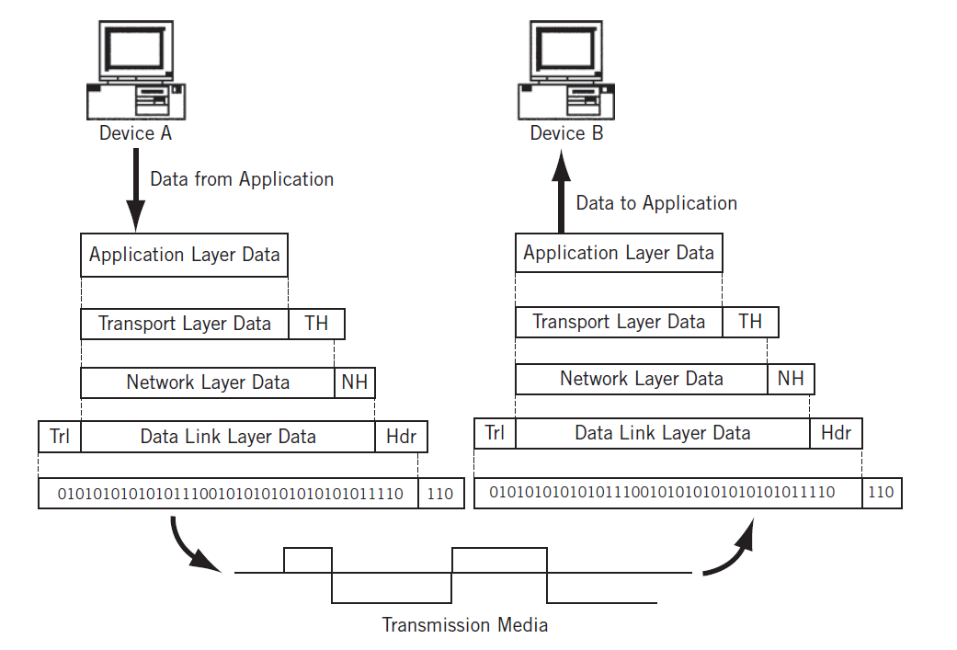
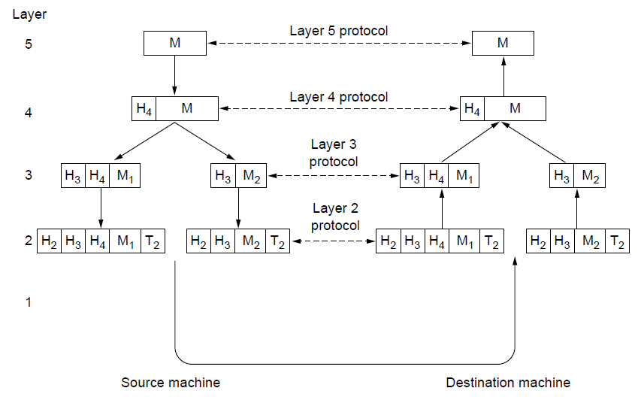
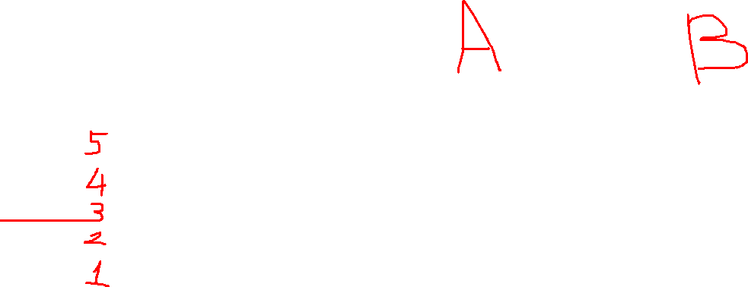
Data Communication between two apps

